Slide 1
Roommate Finding App
Subject Code - CS451
Project Name - Roommate Finding App
Area - App development(Cross-Platform)
Guide’s Name : MISS SHAMA
Group Members
Abay Sevi TJE18CS001
Terin Tom ET TJE18CS036
Sanaljith P TJE18CS030
Aishwarya EK TJE18CS006

Slide 2
A cross-platform application is a mobile app that is compatible with multiple operating systems and can, therefore, run on any smartphone, tablet, PC, smartwatch, and connected TV.
INTRODUCTION

Slide 3
Literature Survey
Paper Name | Problems | Solutions | Drawbacks
Analysis of cross-platform mobile app development tool IEEE | -Lack of user friendly interface | -Test app with real life users and provide a manual. | It will not yield same performance as a native app & long wait time for new features
Flutter development through the flutter clean architecture packages IEEE | -Harder to find appropriate solution for a niche feature. | -We can add packages created by dart programmer community. | Massive file size

Slide 4
Literature Survey
Paper Name | Problems | Solutions | Drawbacks
Sharing and privacy in apps IEEE | Unnecessary authentication. | Auditing app permission. | Does not hide user location.
Designing platform apps independent mobile apps and services IEEE. | Similar app development in all platforms regarding features. | Security patches can be rolled accordance the platform specifically. | Most of its extra features are community driven.

Slide 5
Literature Survey
Paper Name | Problems | Solutions | Drawbacks
Inferring Mobile Apps from Resource Usage Patterns IEEE | Performance of the app depends up on the mobile arch | Moving some process to the cloud resources | Depends on a centralised cloud services
Research on dev of android apps IEEE | Development is too wide spread | Cross Platform can be used to introduce certain standards | It will be efficient as native apps

Slide 6
Problem Identification

Slide 7

Suppose
Let Bob got a New Job

Slide 8

Bob Have to Travel to unfamiliar places

Slide 9
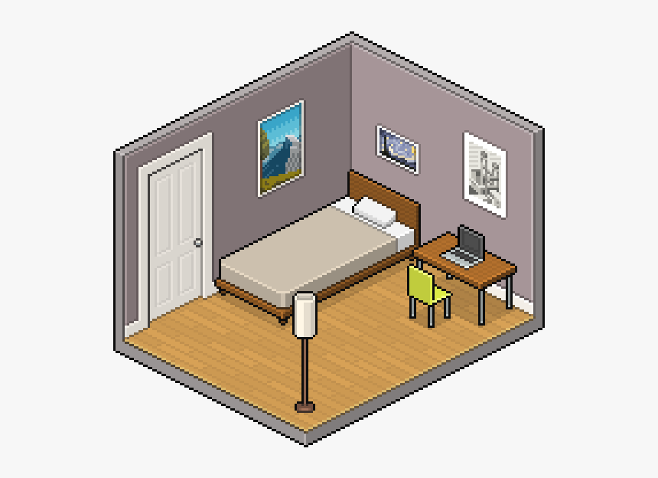
Bob will have to find a place to stay

Slide 10

But Bob’s Job can't afford the price for the rent of the room
#Bob_is_sad

Slide 11
What is roommate app?
It’s an app created to find a roommate with common interests

Slide 12
System Specifications
It created through the framework of dart(AKA flutter).
It is crossplatform.
It has a widely supported libraries for various functions.
Optimised integration with modern hardware architectures.
Flutter is optimal for modern smartphones integrated specs.
Future updates can add integrations to multiple API’s.

Slide 13


API’s Used
Google Maps API
Firebase API
Recommender API

Slide 14

Using the app Bob will be able to find a Roommate who can share
Rent
Food Expenses
And other commodities

Slide 15
Features
Find a roommate
Discuss the price of the room
Find the nearest available room
Create specificities for roommate,i.e., cleaning,cooking,rent sharing.
Add description of features like internet,location etc.
Add specific filters for niche requirement of the host.

Slide 16
Features
Establish rating system for the places which finds a suitable haven.
Capability to post rooms that are available for rent.
Monitoring common expenses taken up by all the parties,and display them individually.
Alert system is established within to act in emergency scenarios like disasters,violence etc.

Slide 17
Conclusion
Roommate culture is being regarded as the goto way for moving out for the current generation.
As such a specialized application created for this will be a great help for this endeavour.
As this code base is open source it can repurposed for other use cases.

Slide 18
Reference
IEEE
Wikipedia
Pub.dev
Google
Google Cloud Developer
Dart.dev
Github

Slide 19
THANK YOU

